Slide 1
Ballot Casting
Team 7: Scorecreepers
Gabriel Sharbel, Evan Hudson, Jacob Nguyen, Paul McKinney, Hunter Mosley

Slide 2
Testing Acceptance Plan

Slide 3
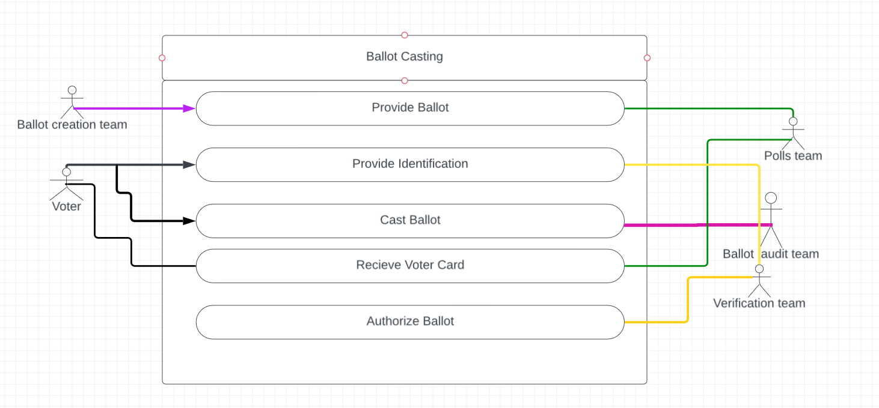

Slide 4
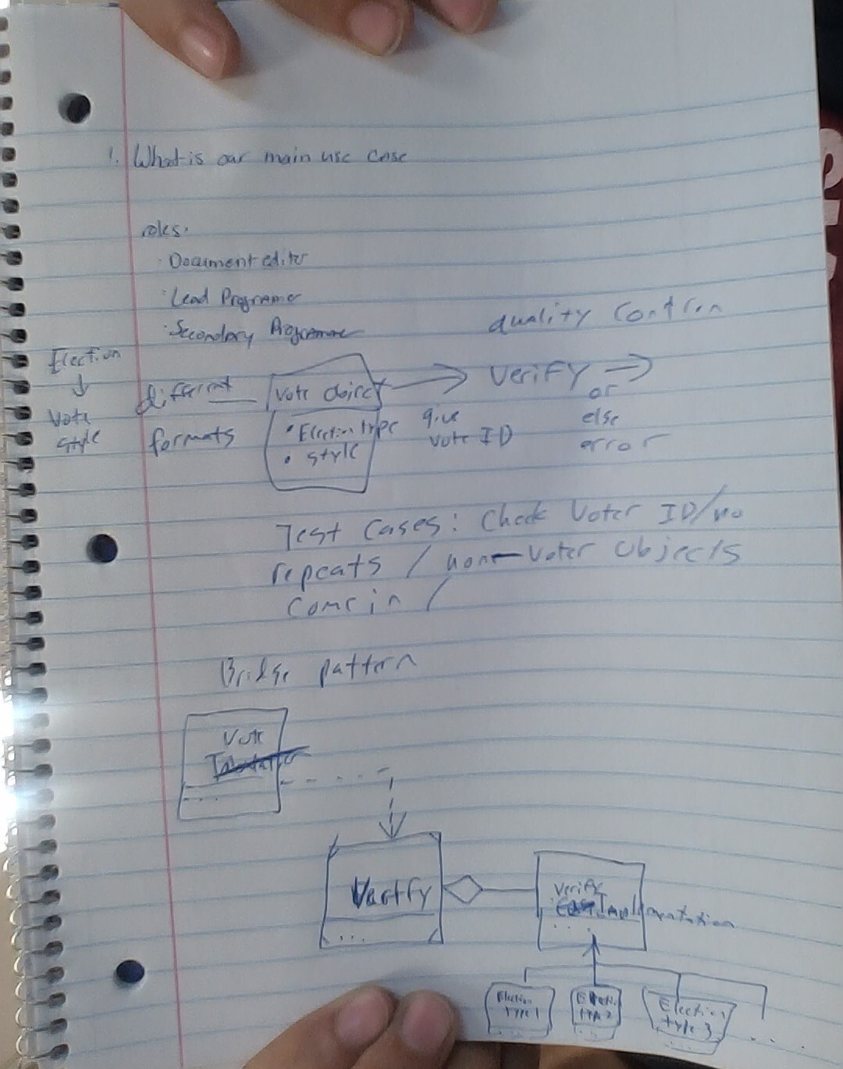

Slide 5
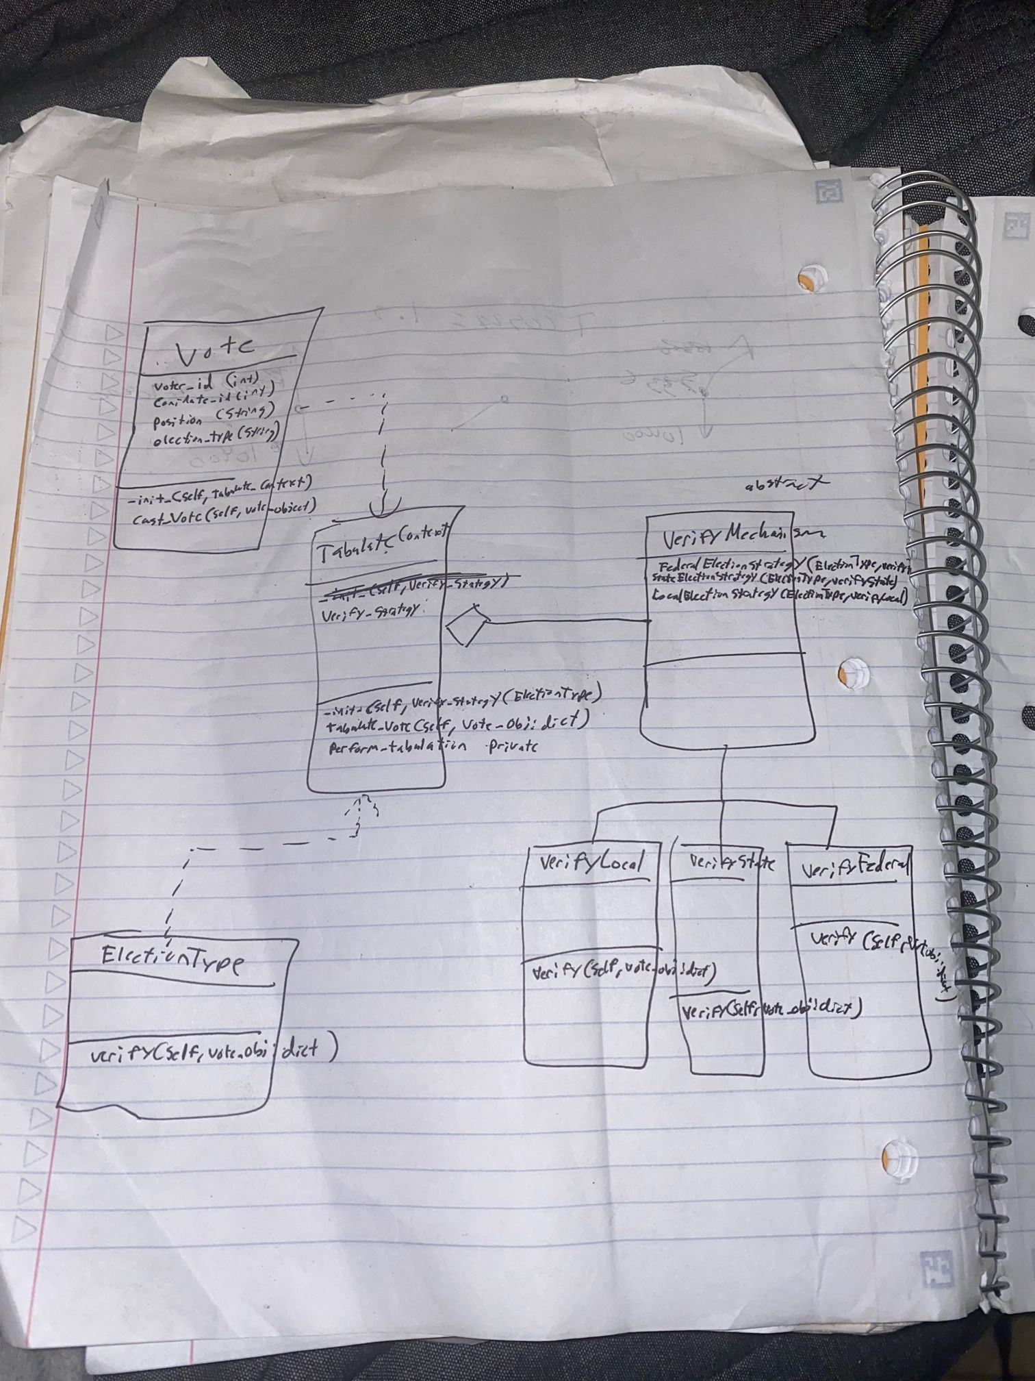

Slide 6


Slide 7


Slide 8
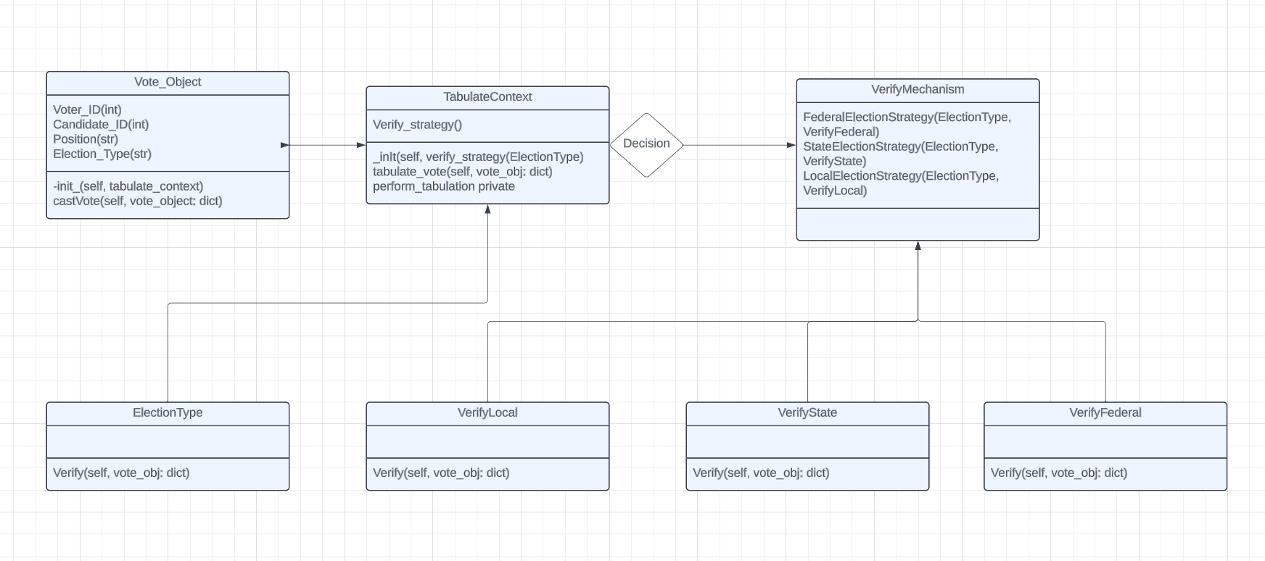
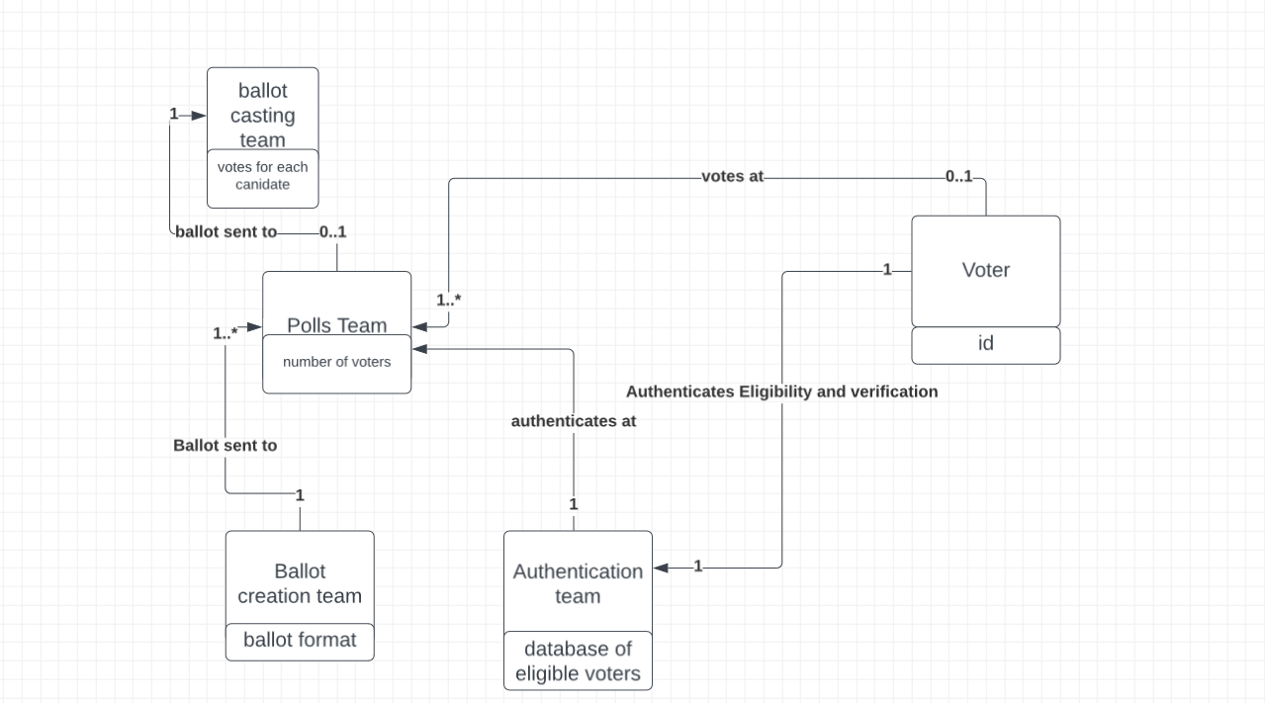
Diagrams

Slide 9
Unit Testing

Slide 10
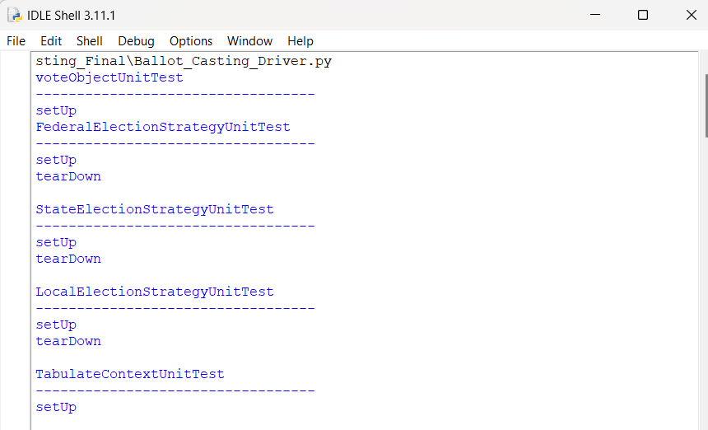

Slide 11
Testing

Slide 12
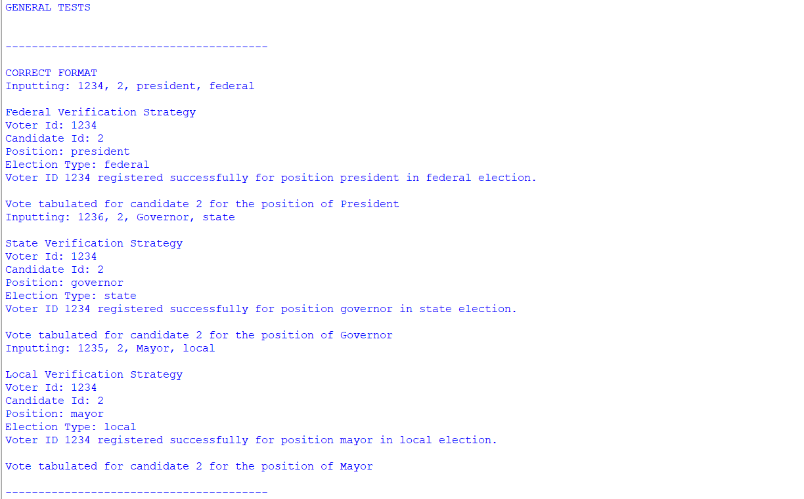

Slide 13
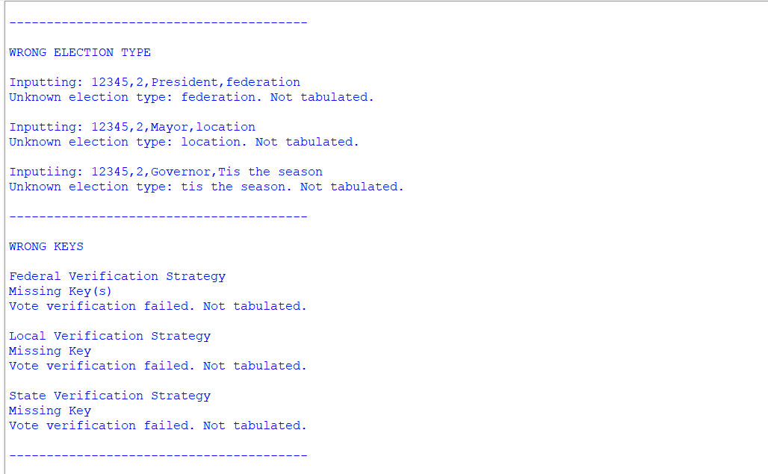

Slide 14
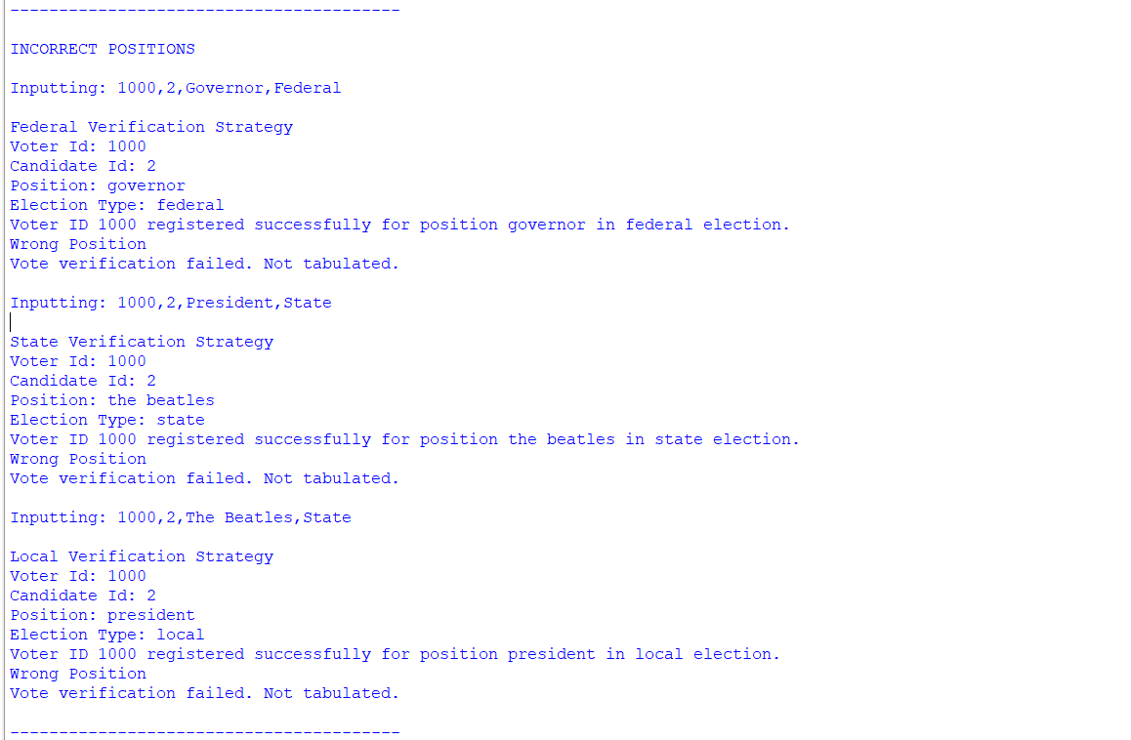

Slide 15
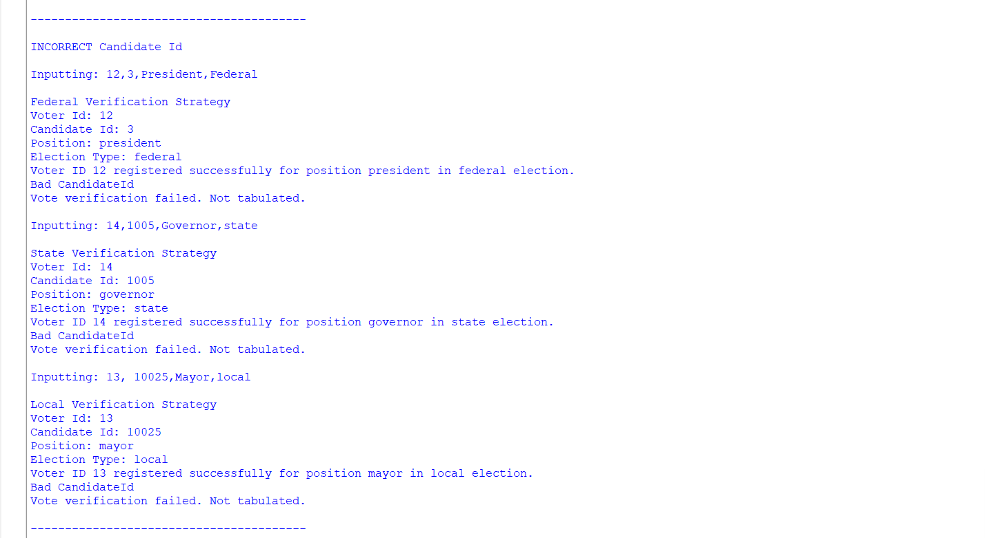

Slide 16
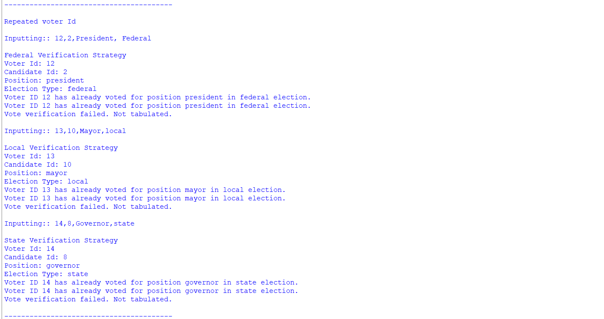

Slide 17
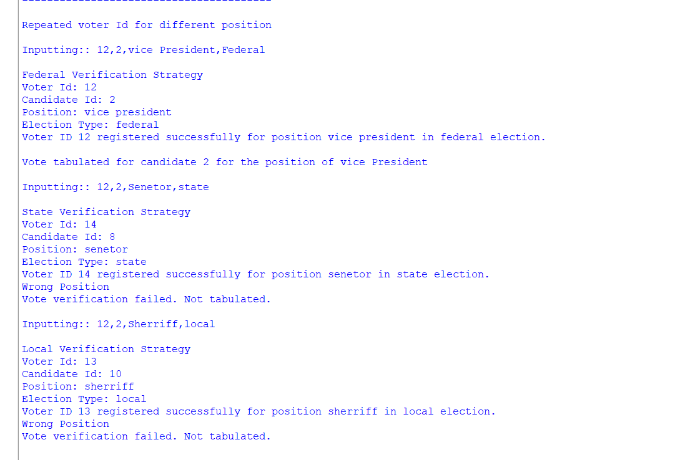

Slide 18
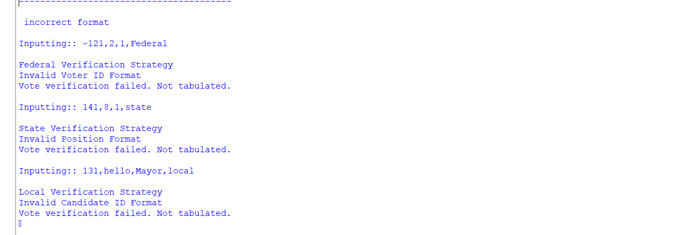

Slide 19
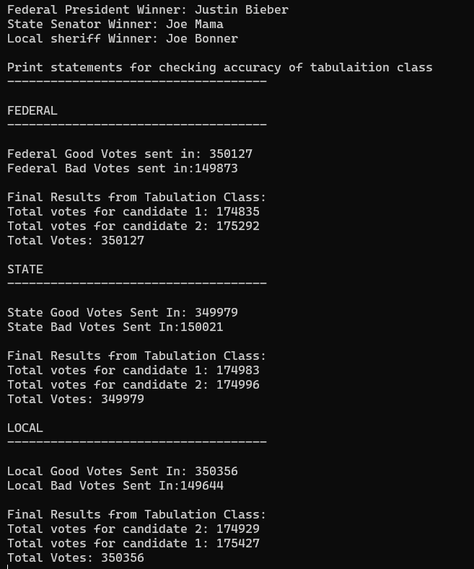

Slide 20
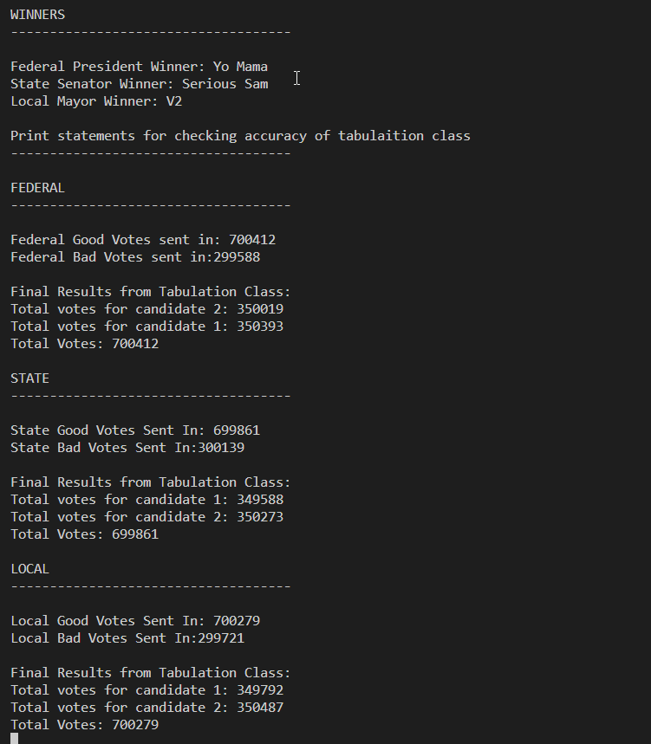

Slide 21
Demonstration
https://replit.com/@Deadpool123456/BallotCasting

